Slide 1
Sakila DVD Rental
A Reflective Analysis On Their Database

Slide 2
Table of Contents
01
02
04
06
Project Details
Brief intro about the company and the data base.
Family Movies Insights
Know About Category
Distribution of sum of rented family movies.
03
Detailed comparison between family movies categories.
Deeper Look
Performance Indicators
Know more about movies which made its corresponding category rise.
05
How the stores perform in each year and in which month they perform better.
Top Customers Insights
Consecutive Monthly Info
How was the interactions of our top customers in 2007.
07
Get to know the differences between monthly payments for the top customers in 2007

Slide 3
Project Detailes
The Sakila Database holds information about a company that rents movie DVDs. For this project, you will be querying the database to gain an understanding of the customer base, such as what the patterns in movie watching are across different customer groups, how they compare on payment earnings, and how the stores compare in their performance.
Database Info
https://www.postgresqltutorial.com/postgresql-sample-database/

Slide 4
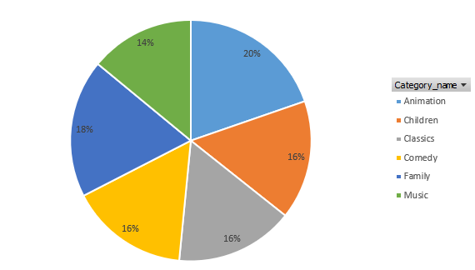
Family Movies Insights
What movie categories that families tend to watch?
And the number of times it has been rented out.
Notes:
This pie chart is created after inserting in an excel pivot table (Movie Category, Sum of rental count)

Slide 5
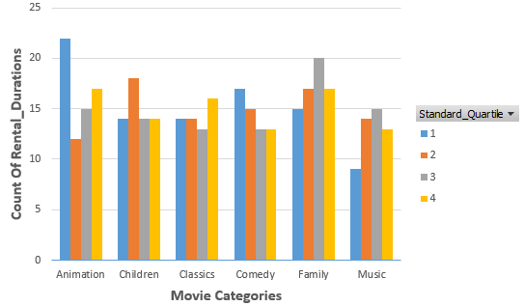
Know About Category
Here is the count of rental durations for each quarter associated with each movie category.
Notes:
This chart is created after inserting in an excel pivot table (Movie Category, Quartiles, Count of rental times), those quartiles are divided based on rental durations for all movies across all categories.

Slide 6
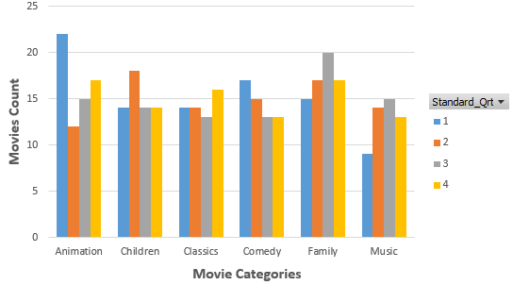
Deeper Look
A deeper look at each category associated with count of movies that have been rented in each quarter.
Notes:
This chart is created after inserting in an excel pivot table (Movie Category, Quartiles, Count of movies in each category), those quartiles are divided based on rental durations for all movies across all categories.

Slide 7
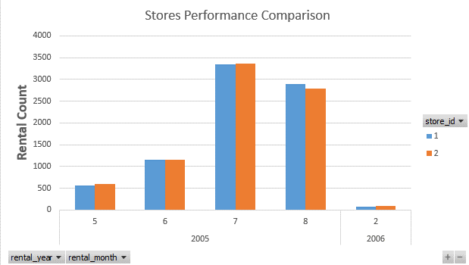
Performance Indicators
How each store perform through out years in different months regarding the rental count.
Notes:
This chart is created after inserting in an excel chart contains (stores, date in years, date in months and rental count), this rental count is the count of how many movies that have been rented from each store.

Slide 8
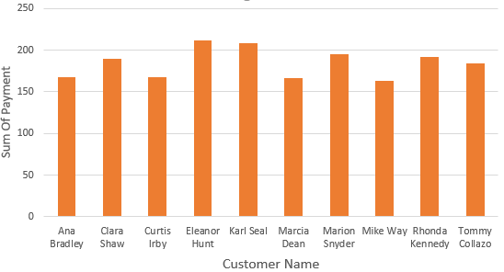
Top Customers Insights
How much did our top 10 customers pay in 2007?
Notes:
This chart is a result of an excel pivot table after summing up the amount of money that each customer have payed in 2007

Slide 9
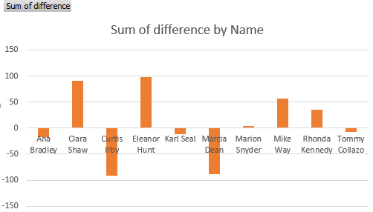
Consecutive Monthly Info
The difference between the consecutive monthly payments that the top 10 customers have made in 2007.
Notes:
This chart is a result of an excel pivot table after summing up the difference between the consecutive monthly payments.

Slide 10
64.87 $
The amount that Eleanor Hunt paid as a max consecutive monthly difference in 2007.
Notes:
This value is a result of query the max difference of monthly payment amount and linking it with the top customers to retrieve the name of the customer associated with this value.

Slide 11
Thanks!
Do you have any questions?
hossamyehia96@gmail.com
+2 010 9378 2298
Please keep this slide for attribution

